Slide 1
Line Algorithm :
DDA and Bresenham

Slide 2
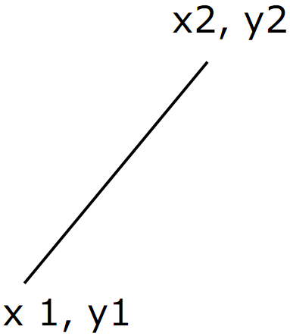
Line
Has four values : x1,y1,x2,y2
Starting point coordinate : (x1,y1)
Endpoint coordinate : (x2,y2)

Slide 3
Line Algorithm : DDA
Int dx = x2-x1;
Int dy = y2-y1;
Int steps,k,x1,y1,x2,y2;
Float x_inc, y_inc;
Float x = x1;
Float y = y1;
If (abs(dx)>abs(dy)) steps = abs(dx) else steps = abs(dy);
X_inc = dx/(float)steps;
Y_inc = dy/(float)steps;
setPixel(Round(x),Round(y));
For(k=0;k<steps;k++) {
x+=x_inc;
y+=y_inc;
setPixel(Round(x),Round(y));
}

Slide 4
Examples
There are two coordinates : A(10,10) and B(17,16), if point A as starting point and point B as endpoint, determine the points that connect between point A and B so that formed AB line using DDA algorithm !

Slide 5
Examples
Starting point = A(10,10)
Endpoint = B(17,16)
Dx= X1-X0 = 17 – 10 = 7
Dy= Y1-Y0 = 16 – 10 = 6
Absolut (Dx) = 7
Absolut (Dy) = 6
Absolut (Dx) > absolute (Dy) maka steps = Absolut (Dx) = 7
X_increment = 7/7 = 1
Y_increment = 6/7 = 0,86
X1 = X + X_increment = 10 + 1 =11
Y1 = Y + Y_increment = 10 + 0,857 = 10,857 =11

Slide 6
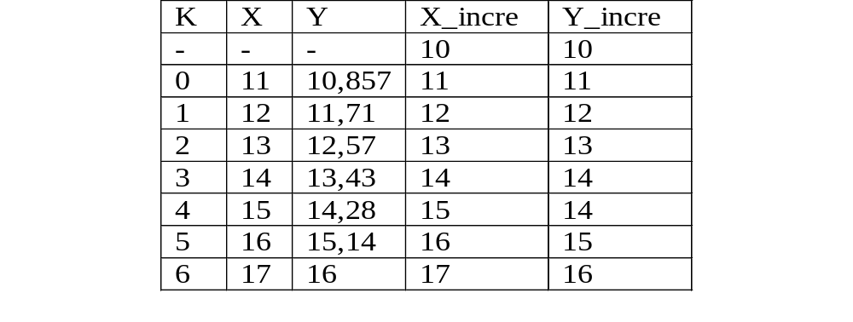
Examples

Slide 7
Steps for Bresenham Algorithm
1. Determine 2 points that will be connected.
2. Determine the starting point (x₁, y₁) and endpoint (x₂, y₂).
Find the values of dx, dy, 2dy dan 2dy - 2dx
Find the value of the parameter : po = 2dy - dx
5. For each xk along the line, starting with k=0
- if pk < 0 then the next point :
(xk+1, yk) and pk+1 = pk + 2dy
- else, next point :
(xk+1, yk+1) and pk+1 = pk + 2dy – 2dx
6. Repeat step 5 to determine the position of the next pixel until
x = x₂ or y = y₂.

Slide 8
Source Code
void linebress(int xa,ya,xb,yb)
{ int dx = abs(xb-xa),dy=abs(yb-ya);
int p = 2*dy-dx, xEnd;
int duaDy = 2*dy, duaDyDx = 2*(dy-dx);
if(xa>xb)
{ x=xb; y=yb; xEnd=xa;}
else
{ x=xa; y=ya; xEnd=xb;}
SetPixel(x,y);
while(x<xEnd)
{ x++;
if(p<0)
p+=duaDy;
else
{ y++;
p+=duaDyDx; }
setPixel(x,y);
}
};

Slide 9
Examples
There are two coordinates : A(10,10) and B(17,16), if point A as starting point and point B as endpoint, determine the points that connect between point A and B so that formed AB line using Bresenham algorithm !

Slide 10
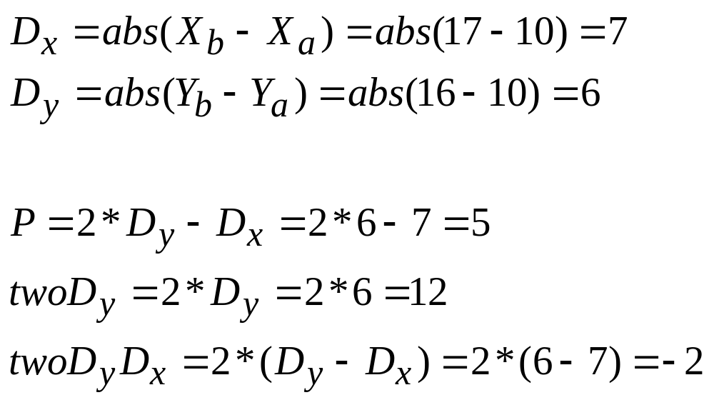
Examples

Slide 11
Examples
K | P_{k} | (X_{k+1} , Y_{k+1})
- | - | 10,10
0 | 3 | 11,11
1 | 1 | 12,12
2 | -1 | 13,13
3 | 11 | 14,13
4 | 9 | 15,14
5 | 7 | 16,15
6 | 5 | 17,16

Slide 12
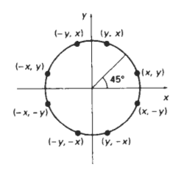
Algoritma Pembentuk Lingkaran

Slide 13
Midpoint
Berdasarkan persamaan lingkaran
r² = x² + y²
Didapatkan fungsi lingkaran
f(x,y) = x² + y² - r²
  f < 0, jika (x,y) di dalam batas lingkaran
  f = 0, jika (x,y) tepat pada batas lingkaran
  f > 0, jika (x,y) di luar batas lingkaran

Slide 14
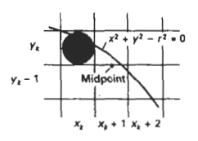
Titik awal (x_{k}, y_{k})
Titik selanjutnya (x_{k}+1, y_{k}) atau (x_{k}+1, y_{k}-1), ambil tengahnya (x_{k}+1, y_{k}-1/2)
p_{k} = f (x_{k}+1, y_{k}-1/2)
p_{k} = (x_{k}+1)² + (y_{k}-1/2) ² – r²
p_{k} < 0, midpoint berada di dalam lingkaran, jika tidak midpoint di luar, pilih pixel di y_{k}-1

Slide 15
Posisi start awal : (x0,y0) = (0,r)
p0 = f(x₀+1, y₀-1/2)
p0 = f(1, r-1/2)
p0 = 1+(r-1/2)²-r²
p0 = 5/4 – r, karena nilai r integer maka dibulatkan menjadi :
  p0 = 1 – r

Slide 16
Langkah-langkah Midpoint
Input r dan titik tengah lingkaran (xc,yc) dan posisi start awal (x0,y0) = (0,r)
Hitung p awal (p=1-r)
Untuk tiap x_{k}, k=0, ulangi sampai x <= y
  Jika p_{k} < 0, (x_{k+1},y_{k}), p_{k+1}=p_{k}+2x_{k+1}+1
  Jika tidak, (x_{k+1},y_{k-1}), p_{k+1}=p_{k}+2(x_{k+1}-y_{k+1}) + 1
Tentukan titik simetri di tujuh oktan yang lain
Pindahkan semua titik pixel (x,y) ke posisi dengan pusat (xc,yc)
  x=x+xc
  y=y+yc

Slide 17
Contoh Soal
(xc,yc) = (0,0) ; r = 4
Posisi start awal x=0, y=4
Titik selanjutnya ?
p = 1-4 = -3, p < 0 jadi titik selanjutnya adalah (1,4), p = -3+2(1)+1 = 0
p = 0, jadi p>=0 maka titik selanjutnya adalah (2,3), p = 0+2(2-3)+1= -1
p = -1, jadi p < 0, maka titik selanjutnya adalah (3,3), p = -1+2(3)+1 = 6
P = 6, jadi p > 0, maka titik selanjutnya adalah (4,2)

